Slide 1
The Relationship Between Traffic Accidents and the Week of the UCSD Quarter
01
RESEARCH QUESTION & HYPOTHESIS
02
BACKGROUND & PRIOR WORK
03
DATASETS
04
WRANGLING & CLEANING
By:
Sumadhu (Genie) Rubaiyat
John Carrion
Girish Krishnan
Sarah Reine Bulatao
Seiji Yang
Ho Lam Woo
05
VISUALIZATION & ANALYSIS
06
ETHICS & PRIVACY
07
RESULTS & CONCLUSION

Slide 2
01
RESEARCH QUESTION & HYPOTHESIS
RESEARCH QUESTION:
Does some ordering of the weeks in a typical UCSD quarter correlate with the number of collisions near UCSD reported to the police?
Does the mile radius around UCSD influence the relationship between these variables?
HYPOTHESIS:
NULL
RESEARCH
The number of reported collisions to the police has no correlation with the week of the UCSD quarter.
The number of reported collisions to the police is highest during the first and last week of the UCSD quarter.

Slide 3
02
BACKGROUND & PRIOR WORK
Work of Anastasia (2014)
Work of Rawat (2020)
Work of Tsai 2019
examines traffic accidents around UCLA, UC Berkeley, and CSU Sacramento
Data: both police reported and self-reported accidents in collision "hotspot" areas
Results: traffic accidents were most prevalent in "campus activity hubs, campus access hubs, and through traffic hubs"
Note the paper mentioned that there is a significant underreporting of crashes
analyzes traffic collisions in the SD area and identifies which days of the week tend to have more collisions
Results: the number of injuries was greatest on Friday and the number of deaths was greatest on Monday
Note there were no statistical tests performed to verify that these trends were significant and there were issues with the times of the accident being imprecise
performs data analysis on traffic accident dataset covering the USA
visualized the number of road accidents as a function of time in years, showing how the number of accidents of each severity level have increased from 2015 to 2019
Results: visibility and weather conditions did not significantly affect the presence of road accidents
[^rawat2020]: Rawat, S. (2020, September 16). USA Accidents Data Analysis. Towards Data Science. Retrieved July 15, 2023, from https://towardsdatascience.com/usa-accidents-data-analysis-d130843cde02
[^anastasia2014]: Anastasia Loukaitou-Sideris, Aditya Medury, Camille Fink, Offer Grembek, Kevan Shafizadeh, Norman Wong & Phyllis Orrick (2014) Crashes on and Near College Campuses: A Comparative Analysis of Pedestrian and Bicyclist Safety, Journal of the American Planning Association, 80:3, 198-217, DOI: 10.1080/01944363.2014.978354. Link: https://www.tandfonline.com/doi/full/10.1080/01944363.2014.978354
[^tsai2019] Nathan Tsai, Bernard Wong, and Sally Poon, San Diego Traffic Collision Analysis, (2019), GitHub repository, https://github.com/nhtsai/datathon2019

Slide 4
03
DATASETS
Quarter Start/End Dates scraped from UCSD's Academic and Administrative Calendars
Dataset Name: UCSD Quarter Start and End Dates
Link to the dataset: ./start_end_dates.json
Number of observations: 20
Each observation contains the start and end date for Fall, Winter, and Spring quarters, in that order, and the key corresponds to the academic year
Covers all quarters from 2003-2024
Scraped from the URL format: https://blink.ucsd.edu/instructors/resources/academic/calendars/[YEAR].html
Traffic collision reports recorded by the San Diego Police Department
Dataset Name: Traffic collisions (2015 through year-to-date)
Link to the dataset: https://data.sandiego.gov/datasets/police-collisions/
Number of observations: 64210
Describes traffic collisions reported to the SDPD 2015-present
Contains information about the date, time, location, type of collision, number of injuries, and the number of fatalities
Note this is data that is reported to the SDPD so it may not be a complete record of all traffic collisions that occurred in San Diego (as there may be collisions that were not reported to the police)
Plan for combining these datasets
We plan to categorize each observation in the Traffic Collision Reports by Week 1-10 in their academic quarter, as well as adding columns for the quarter and year. To do this, we will apply a function to convert the datetime of each observation into its respective week, quarter, and year by checking the date_time against the start_end_dates database.

Slide 5
04
WRANGLING & CLEANING
Define function using a web scraper to parse through table on the UCSD administrative calendar to find start and end dates for each quarter
Define function to discern the week of the quarter from the date, using json file
Drop unnecessary columns, and rows with null values
1
3
5
7
2
4
6
Import SDPD Traffic Collision Data
Use function to parse through and store values in a local json file
Merge datasets by converting the date column of the SDPD Traffic Collision Data
Convert address columns of resultant dataset to Lat/Long coordinates, and create another dataset with only collisions within a 10 mile radius of UCSD

Slide 6
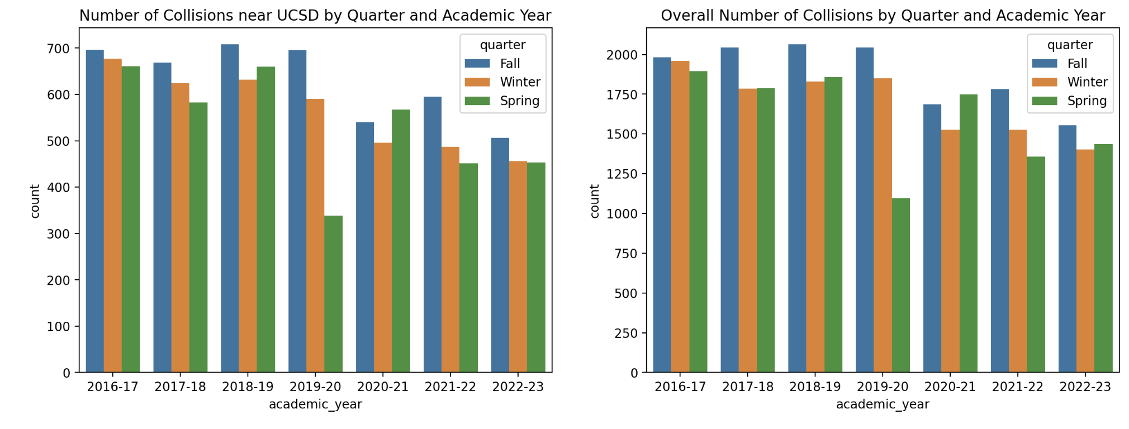
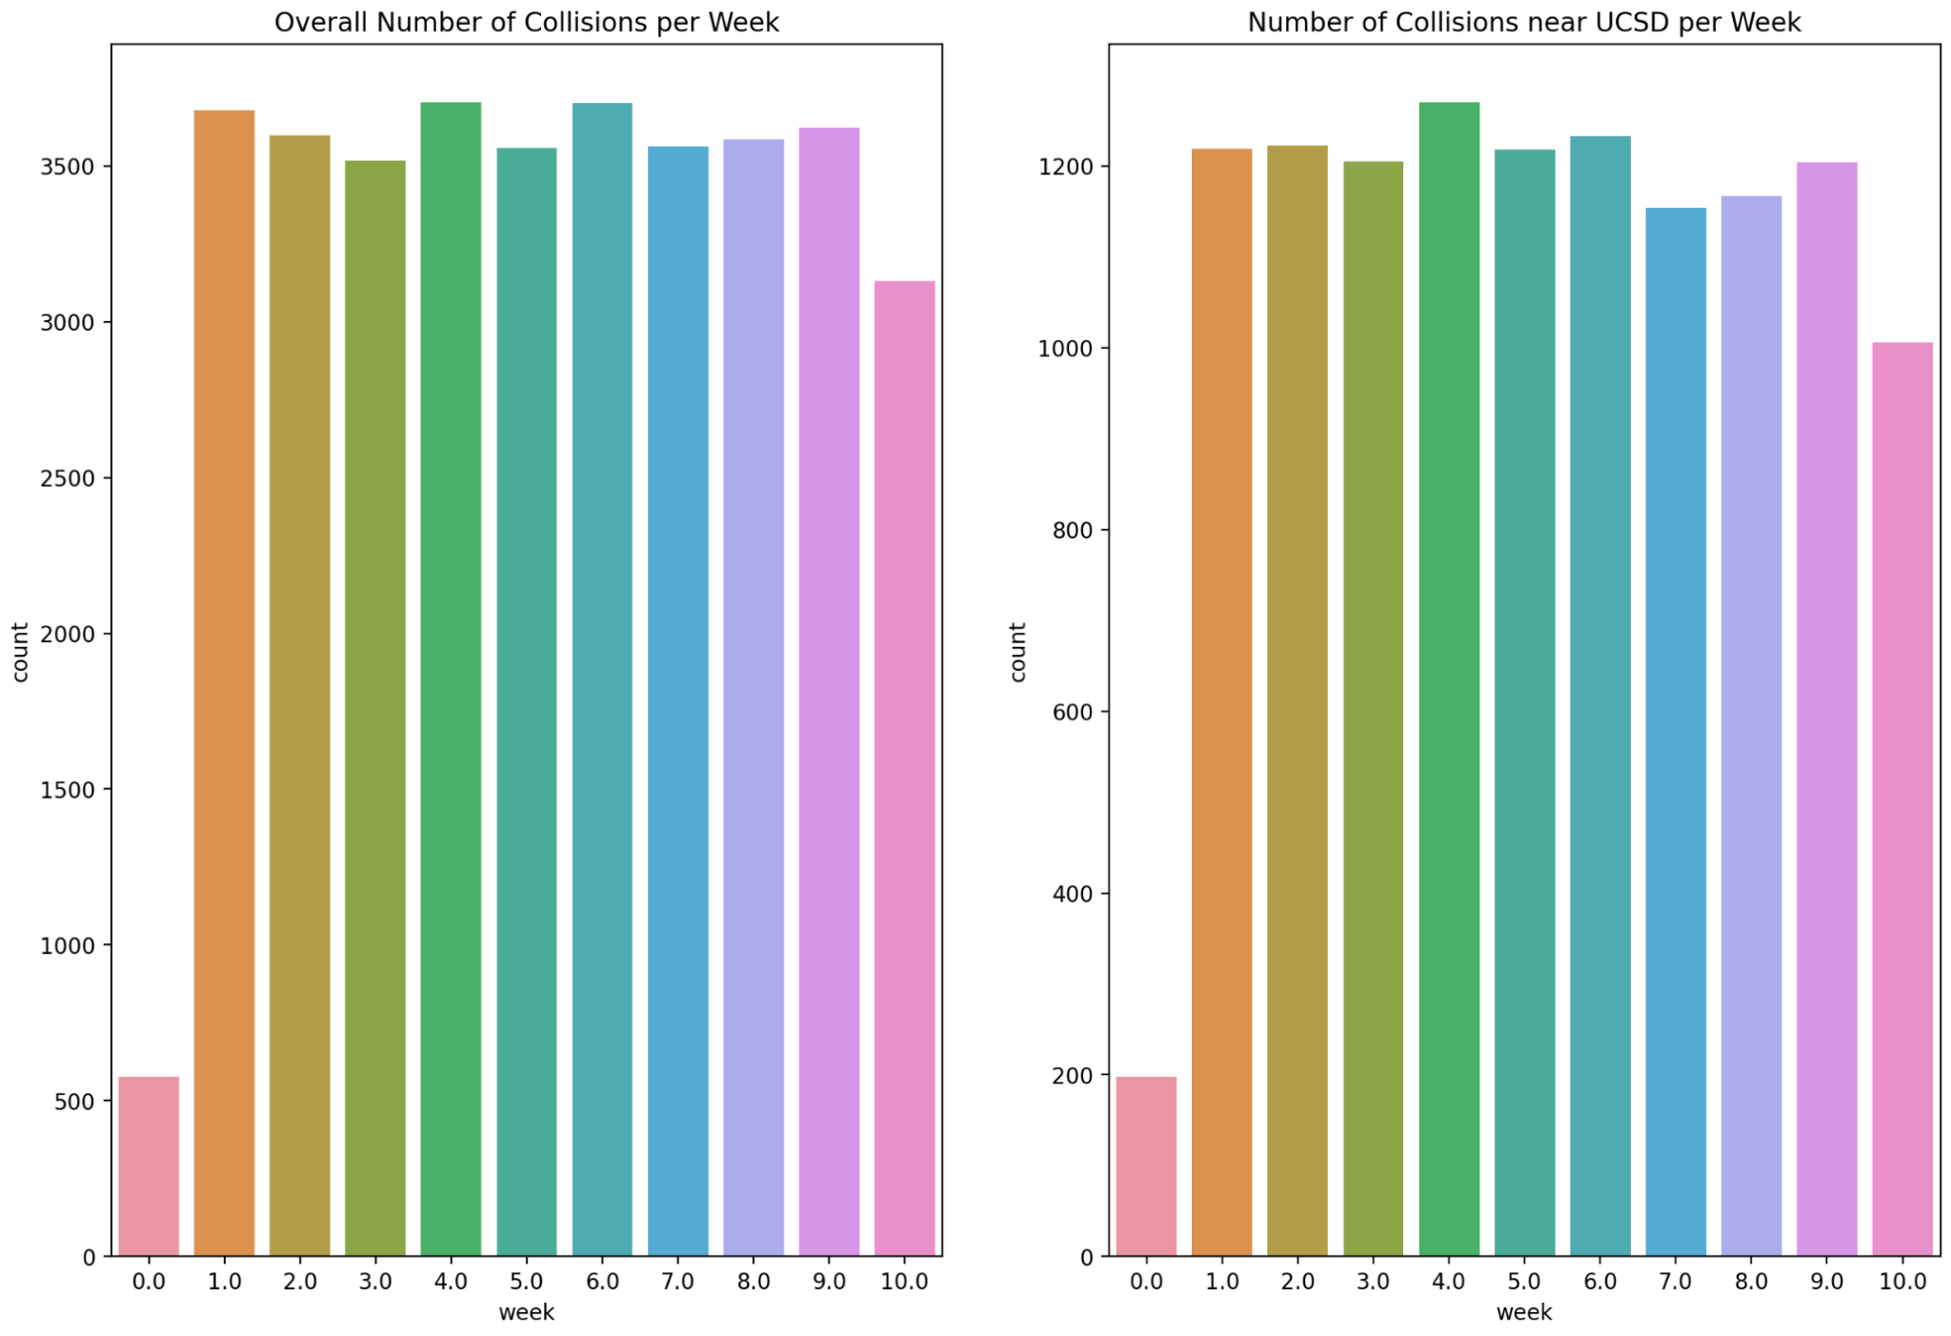
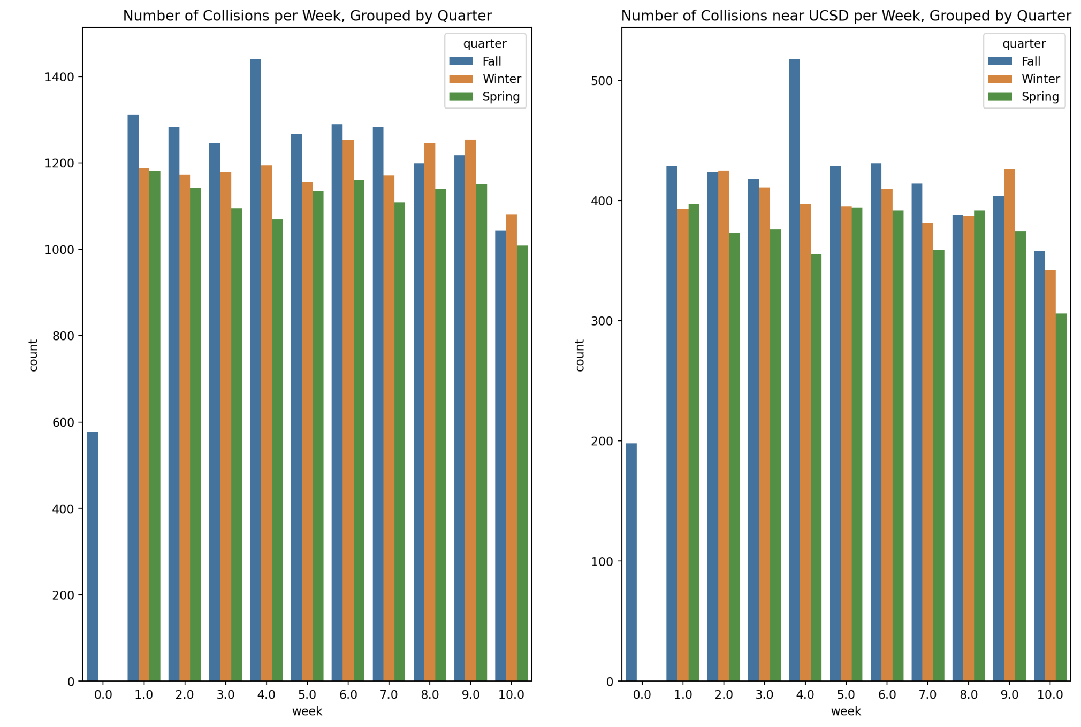
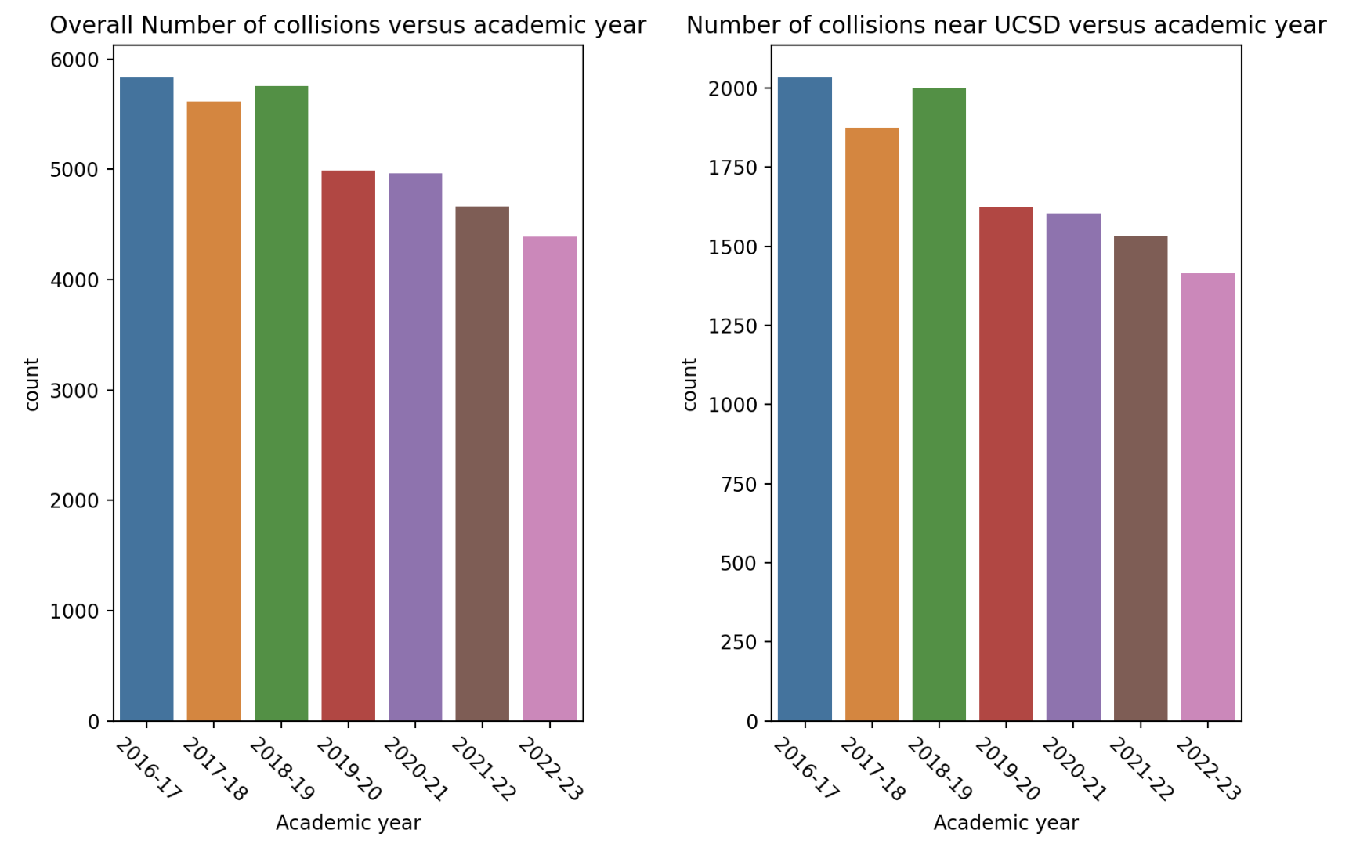
5.1
VISUALIZATION & ANALYSIS

Slide 7
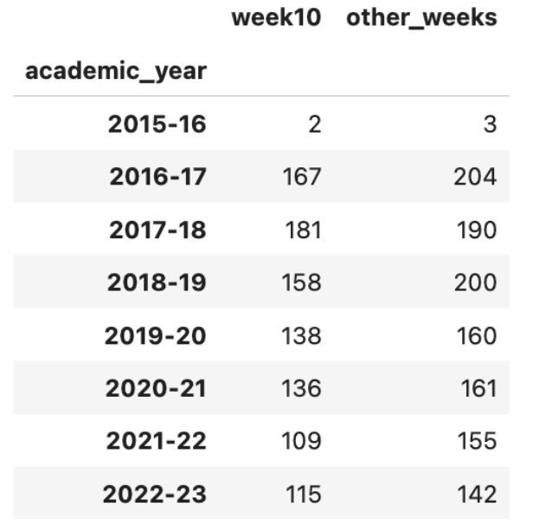
5.2
Does Week 10 have fewer collisions?
Collisions in Week 10 compared to the median number in other weeks.
Mann-Whitney U Test Statistic = 17.0
p-value = 0.065
Fail to reject H₀: Week 10 does not have a significantly lower number of collisions

Slide 8
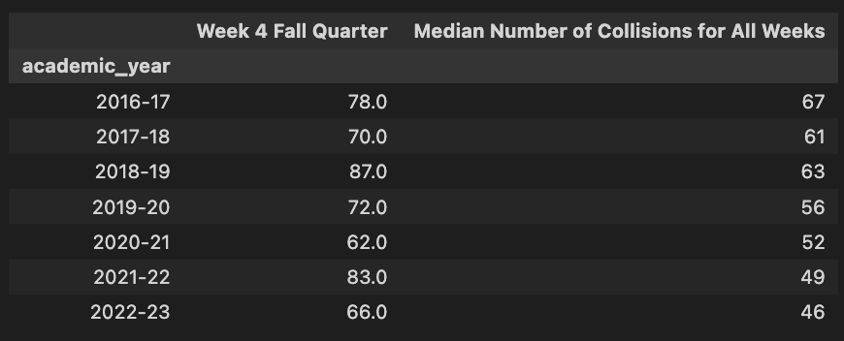
5.3
Does Week 4 of Fall Quarter have an unusually high number of collisions?
Collisions near UCSD
Collisions in Week 4 of Fall Quarter compared to the median number in other weeks.
Mann-Whitney U Test Statistic = 53.0
p-value = 0.00109
Reject H₀: Week 4 has a significantly higher number of collisions

Slide 9

5.4
Does Week 4 of Fall Quarter have an unusually high number of collisions?
All Collisions in San Diego
Collisions in Week 4 of Fall Quarter compared to the median number in other weeks.
Mann-Whitney U Test Statistic = 59.0
p-value = 0.00210
Reject H₀: Week 4 has a significantly higher number of collisions

Slide 10
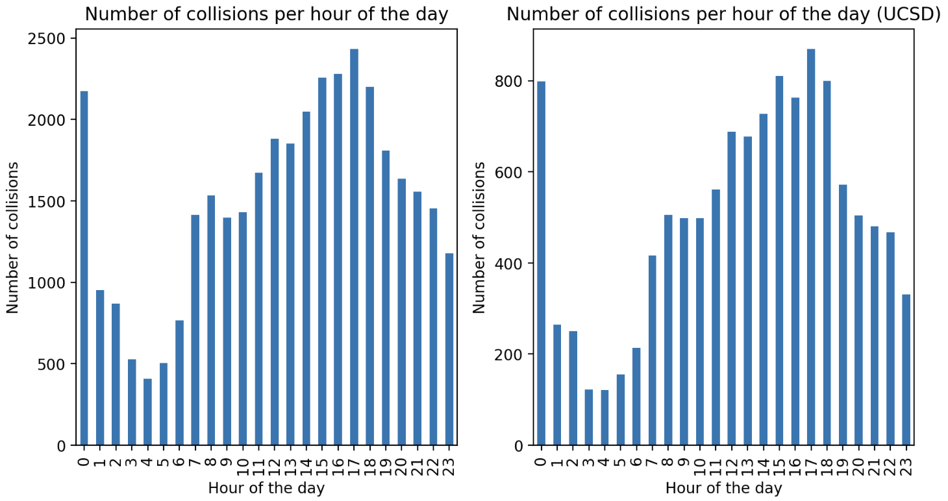
5.5
VISUALIZATION & ANALYSIS
Kruskal-Wallis H test
(5% significance level)
The distribution of the number of collisions with respect to the time of the day is the same near UCSD and elsewhere.

Slide 11
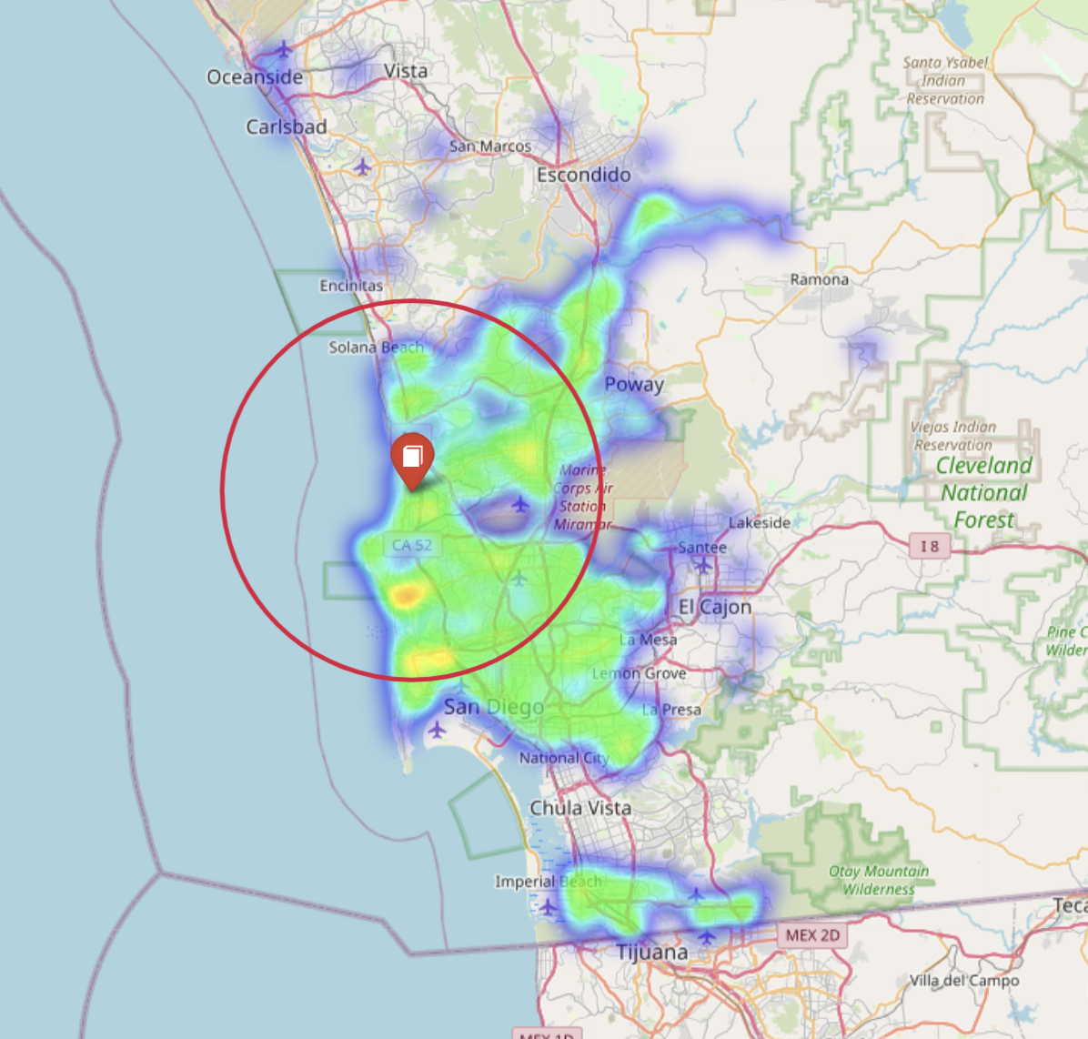
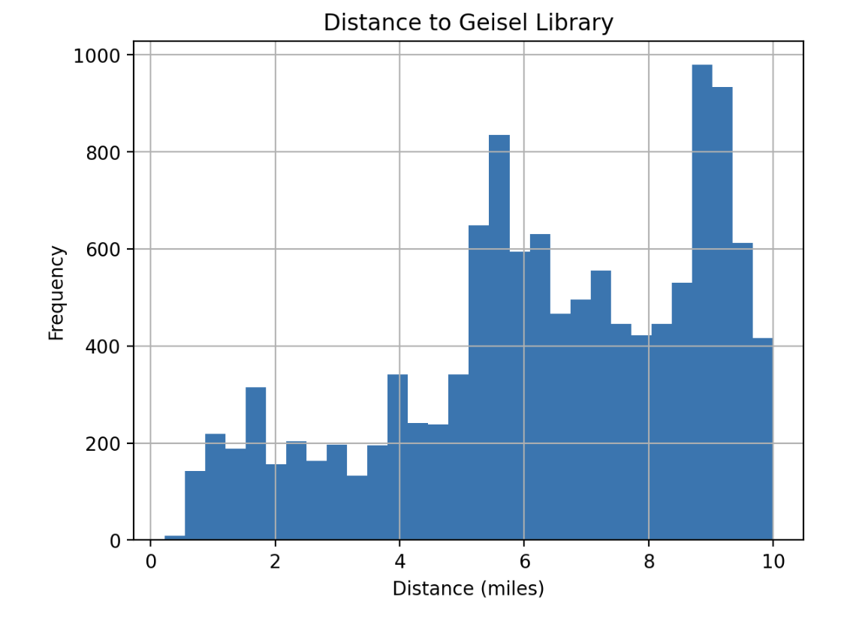
06
ETHICS & PRIVACY
Data collection is not a concern, because we only use public data. We, however, do not publish copies of our dataset, in case the parties cited decide to remove it as a result of privacy concerns. We cite instead.
Certain areas may be less likely to report collisions to the SDPD, so that should be kept in mind. However, it should be quite a good approximation.
We can see our data is biased towards not as many collisions near UCSD from the figures at the right. We dealt with this by creating 2 different datasets: one with all the collisions and one with only collisions within 10 miles.

Slide 12
07
CONCLUSION
Limitations
The dataset only comprised of collisions that were reported to the police.
Our analysis included a rough 'radius' of 10 miles from UCSD's Geisel library. There may have been more detailed ways to examine or filter the dataset for UCSD students.
Some addresses in the dataset were messy and couldn’t be converted to Lat/Long coordinates.
Results
We found that there was no statistically significant difference between the distribution of collisions within a 10 mile radius of UCSD and collisions from the general San Diego area, both with and without grouping by weeks in an academic quarter.
We do note a statistically significant jump in collisions (p < 0.01) during Fall Quarter's Week 4, both for the UCSD and general San Diego area. What happens around the end of October that causes more collisions?
We do not reject our null hypothesis ⇒ there is no significant relationship between the weeks of the UCSD quarter and the number of reported collisions.
Why do we see such a huge spike in the number of reported collisions in Fall Quarter's Week 4?
What other methods can we use to investigate specifically UCSD students living off campus?
Future Questions

Slide 13
The Relationship Between Traffic Accidents and the Week of the UCSD Quarter
Thanks for listening!
By:
Sumadhu (Genie) Rubaiyat
John Carrion
Girish Krishnan
Sarah Reine Bulatao
Seiji Yang
Ho Lam Woo

